Slide 1
Mrs. Sabrina’s College Prep Class
First days of school

Slide 2
Mrs. Sabrina Suluai-Mahuka
Graduated from Samoana High School
Graduated from ASCC with an AA in Liberal Arts
Graduated from UH Manoa with a Bachelors in Education and a Masters in Curriculum Studies
Passed Praxis I & II Teacher Certification Exams
Taught 9th & 12th grades for 4 years and 2 years as Dept. Head of ELA at FMHS, and 1 year at SHS
Currently in a PhD program with UHM
Working as a Graduate Assistant for UHM

Slide 3
Questions
In your groups, take 30 seconds to come up with a question or two that you want to ask me.
Questions can be personal or professional (just don’t be too ridiculous).

Slide 4
Introduction to the Syllabus
Grade percentages
Class materials:
Pens, pencils, lined paper, highlighters, 1 notebook, flash drive, 3 ringed binder
Class website: elawithsabrinamahuka.weebly.com
Edmodo Group code: 8wc92k
Syllabus
Vocabulary lists
Journal entries
Other Resources: PowerPoint presentations,
study guides, etc.

Slide 5
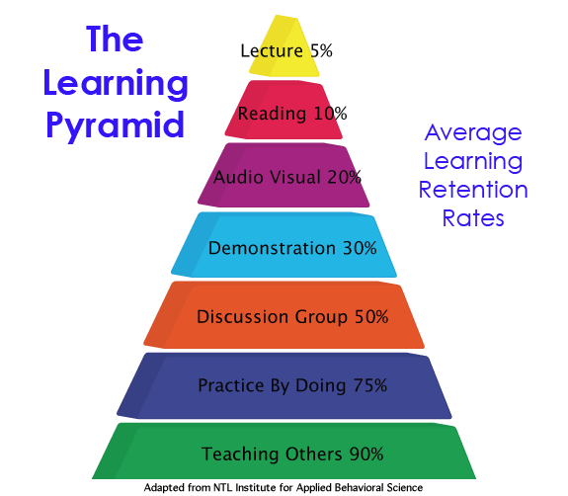
Assignment Expectations
Notes:
This is the reasoning behind the structure of the class.

Slide 6
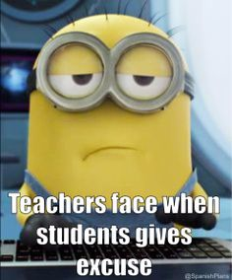
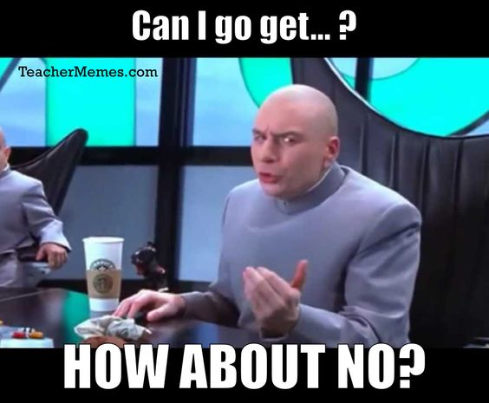
Expectations:
Attendance and participation:
Absences
Tardiness
In-class presence
Come prepared to class
Materials, bags where they belong, look at the day’s agenda and prepare to work
Teaching style: Facilitator
More emphasis on responsibility
Limit your excuses

Slide 7
Positive
Negative
Class earns “stars”
Stars = more privileges
Monthly teacher coupons
Extra credit learning centers
Verbal warning
Last to leave the room
Detention
Minionship

Slide 8
Class Rules
Respect yourself and your future.
Respect your classmates and their right to learn.
Respect your teacher.
Respect your school and your community.

Slide 9
Tip #1: Listen to Instructions

Slide 10
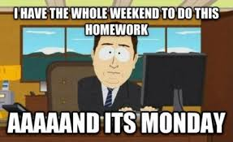
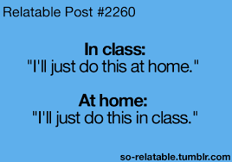
Tip #2: Stay on Task

Slide 11
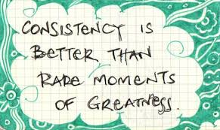
Tip #3: Be Consistent

Slide 12
Tip #4: Study Smart

Slide 13
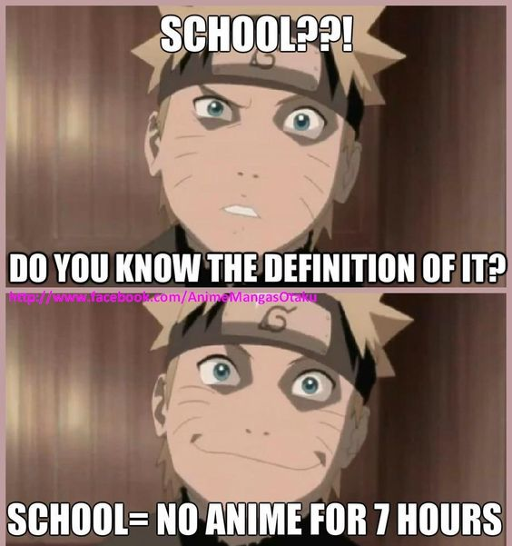
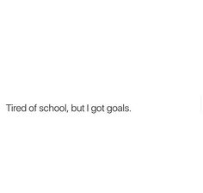
You are SENIORS!

Slide 14
I am poem
When I am by myself
And I close my eyes
I am a _____________
I am a _____________
I am a _____________
I am a _____________
I am a _____________
I can be whatever
I care to be
And when I open my eyes,
What I care to be is me
Notes:
Famous psychologist Erikson found that if children do not form a sense of identity, they will not be successful in life. You need to know who you are, what community you belong to. Therefore, there will be community builders in class.

Slide 15
Journal entries
Basics
Advance
Brainstorm – web or outline
5 paragraphs each entry – introduction, body (3 paragraphs), and conclusion
Vocabulary words – 5 from the current set, highlighted
Written in academic language
No simple sentences
No contractions
Journals will be based on the readings and will follow the format:
Introduction
3 “Aha” moments
What stood out to you?
Why?
Conclusion

Slide 16
Vocabulary sets: Kaplans’ top 100 SAT words and Princeton Review Top 100 SAT words
Each entry looks as follows:
1. Word: definition
Part of Speech (POS)
Derivatives (different forms of the word)
Sentence (academic, not simple)
Sample entry:
Ascertain: to determine or figure out
POS: Verb
Derivatives: Ascertained
Sentence: From the reading, I was able to ascertain the meaning of the word by using context clues.

Slide 17
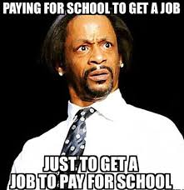
The Reality of Life

Slide 18
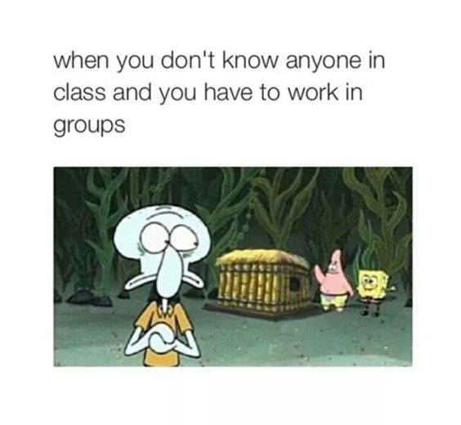
Being able to collaborate and cooperate are two valuable skills.
Working Collaboratively:
Working together as a group on a assignment all at the same time. For example: You are all editing a paragraph together.
Working Cooperatively:
Working together as group but on different tasks. For example: You divide your literature roles and you each do your own tasks and put your work together.
Notes:
Get ready to work with people you don’t like, you don’t know, and you don’t want to know.

Slide 19
Shapes personality Test

Slide 20
Groups
Now that you have picked your shapes, get into a group that has at least ONE of every shape!!!

Slide 21
SQUARE You’re an organized, logical and hardworking person who likes structure and rules. But sometimes you have trouble making decisions because you always want more information.
How to spot a square: They appear to move stiffly, use precise gestures, love routine and are very concerned with detail. They’re also very neat in their appearance and work space. They do a lot of planning and are always prompt.
Every team needs a Square!

Slide 22
TRIANGLE You’re a born leader who’s competitive, confident and decisive. You also like recognition and are interested in politics. American business has traditionally been run by triangles and they’re usually men.
How to spot a triangle: They’re very stylish and expensive dressers. They have powerful voices, love to tell jokes and play as hard as they work.
Every team needs a Triangle!

Slide 23
SQUIGGLE You’re a creative person who’s always thinking of new ways to do something. But you don’t think in a deliberate pattern from A to B to C. Instead, you tend to jump around in your mind, going from A to M to X.
How to spot a squiggle: They’re flamboyant, dramatic and extremely creative – and they don’t like highly structured environments. Both men and women squiggles tend to be sexy, witty and very expressive. They also have great intuition. Most performers and writers are squiggles.
Every team needs a Squiggle!

Slide 24
CIRCLE You’re a “people person” with lots of sympathy and consideration for others. You listen and communicate well and are very perceptive about feelings. You like harmony and hate making unpopular decisions.
How to spot a circle: They’re friendly, nurturing, persuasive and generous. They tend to be relaxed and smile a lot. They’re talkative, but have a mellow voice. They also have a full laugh and love to touch others on the shoulder and arm.
Every team needs a Circle!

Slide 25
You will learn to work with others who are NOT the same as you.
Chances are, you have a predominant shape/personality type and a secondary one – can you identify both?

Slide 26
Communication Skills (O)
Clearly convey a message and check for understanding (retell)
Use “I” statements
Avoid “You” statements
Memorize Two Quotes
Gestures and Body Language

Slide 27
Factors to consider when choosing a college.
The Basics
Notes:
Off the top of your head, what are some factors to consider when you choose a college?

Slide 28
College
Cost
Tuition
Other
Interests
Major
Room & Board
Food
Phone Bill
Internet
Books
Hygiene Items
Food

Slide 29
Interests
Majors:
What majors are available at this college?
How valid are the degrees for the that major?
Environment:
Can I adapt to the foreignness?
What is the community like?
What jobs can I get with this major?
Where can I get support?

Slide 30
Costs:
Tuition
By semester
By year
Books
Per class
Multiple texts
Phone Bill
Phone
Monthly plan/contract
Internet
Dependent on plan
Dependent on location
Room & Board
Dorm
Apartment
With family
Food
Food plans
Groceries
With family
Hygiene Items
Items for regular use
Notes:
Pause and have the students make a list of all the hygiene items that they use on a regular basis.
Project will be to pick the most prevalent universities from the students’ choices and they will have to find the average cost of living for that school.

Slide 31
Interactive Strategy: Calculate the average cost for ONE year of college.
Considering the factors we just discussed, get into your small groups and estimate the cost of one year of college. Factors are:
Tuition
Books
Room & Board
Food
Phone Bill
Internet
Hygiene Products

Slide 32
So the question is: Who is going to pay for these costs?
Scholarships
Loans
Family
You

Slide 33
So Here’s Your Task:
In your small groups, find 5 scholarships that YOU and your classmates can apply for.
Be sure to note the deadline, the award amount, and the stipulations!
Notes:
NO ASG, Bluesky or Starkist

